Slide 1
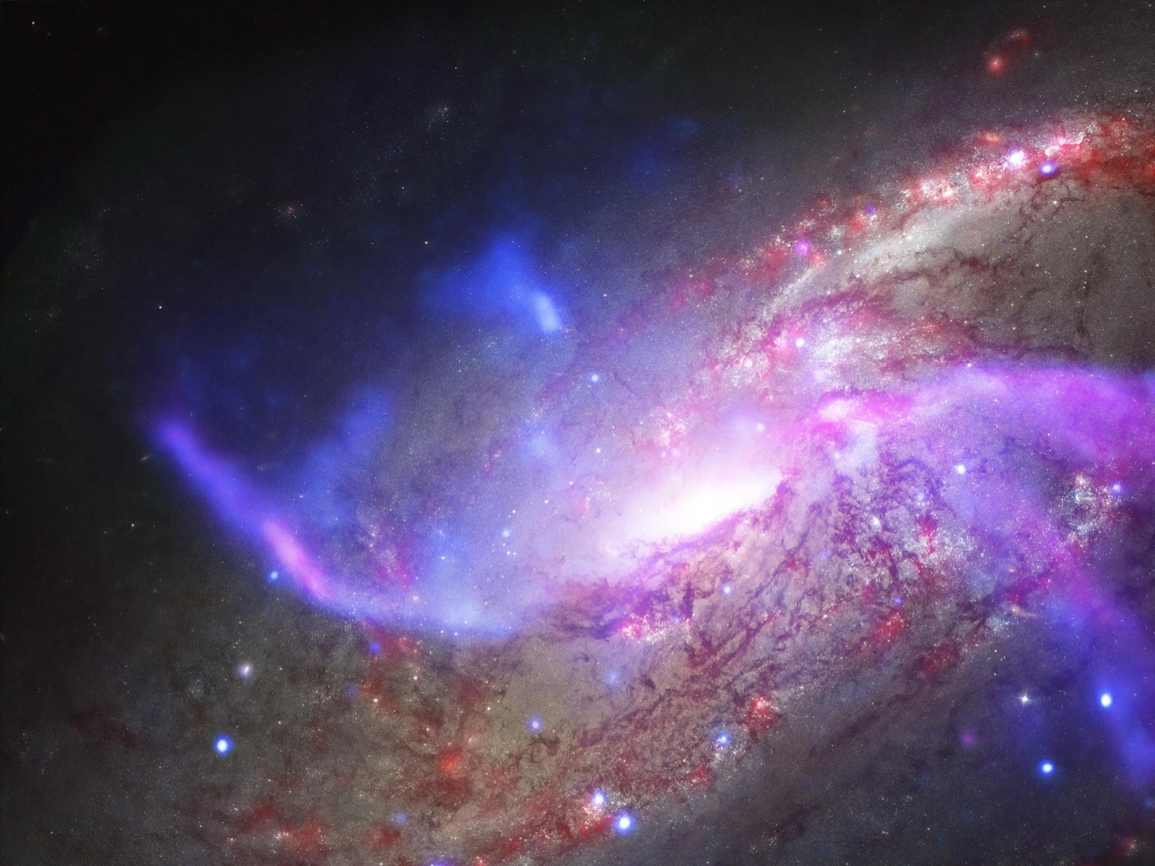
Bringing SysML Models to Life: Introduction to Behavioral Semantics – A Case Study For SysML v2
Robert Karban
Jet Propulsion Laboratory, California Institute of Technology
September 23-27, 2019 – OMG Technical Meeting, Nashville, TN
The cost information contained in this document is of a budgetary and planning nature and is intended for informational purposes only. It does not constitute a commitment on the part of JPL and/or Caltech. Reference herein to any specific commercial product, process, or service by trade name, trademark, manufacturer, or otherwise, does not constitute or imply its endorsement by the United States Government or the Jet Propulsion Laboratory, California Institute of Technology.
© 2019 California Institute of Technology. Government sponsorship acknowledged.
Notes:
Thank you for introduction
Good morning and thank you all for coming
Want to tell you a bit about mbse at jpl, motivation for it, and how we apply it; what we research on
Talk is in three parts: first, intro, second application, then one example of research

Slide 2
Goals for this Session
Teach basics of commonly used behavioral specification diagrams in SysML
Introduce, and demonstrate key features of, Cameo Simulation Toolkit
Motivate importance of formal modeling and adherence to SysML language standard
Notes:
What is the Cameo Simulation Toolkit?
Behavior Specification in SysML
Executing Simulations
Demo
Closing

Slide 3
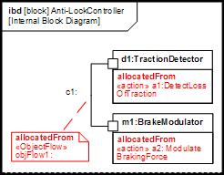
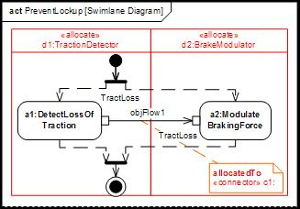
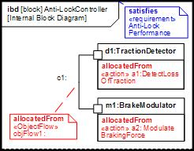
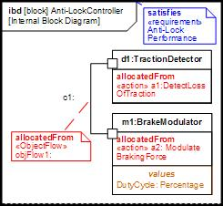
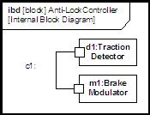
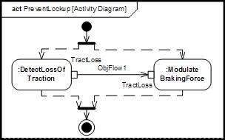
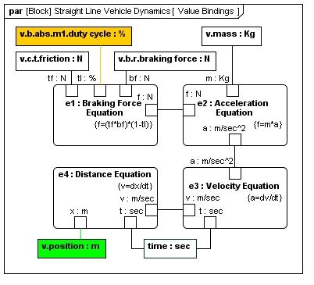
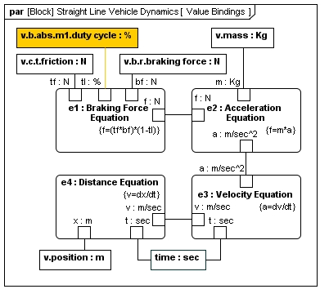
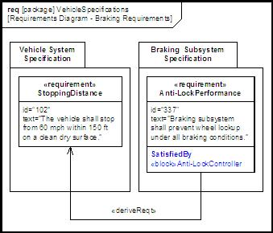
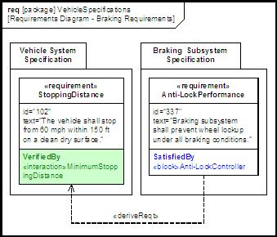
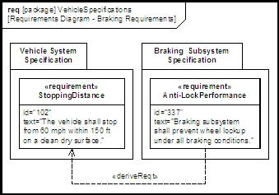
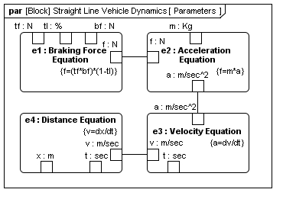
Revisiting the Four “Pillars” of SysML
(Source: Friedenthal, www.omgsysml.org)
1. Structure
2. Behavior
interaction
state
machine
allocate
activity/
function
value binding
satisfy
Verify
3. Requirements
4. Parametrics
Notes:
4 types of cross-connecting principles:
Allocation
Requirement satisfaction/derivation
Value Binding/Parametrics
Requirement Verification

Slide 4
Agenda
Specifying Behavior in SysML
Owned vs. Classifier Behavior
Activity Diagrams
State Machines
Executing System Behavior Simulations
Demo
Key Take-Aways

Slide 5
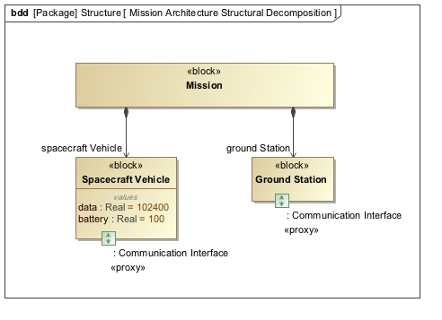
Running Example: Simple Space Mission
Goal: Send Science Data to Ground Station
No data to be transmitted if battery level falls below 40%
Send again if above 80%, and GS ready
Recharge whenever battery level below 80%, and only until 100%
How long does it take to transmit all of the science data? What is the battery level profile over time?
Notes:
Ground station and spacecraft
Spacecraft sends data, to ground station, ground station pings
Spacecraft is in eclipse, or not, collects power, uses power

Slide 6
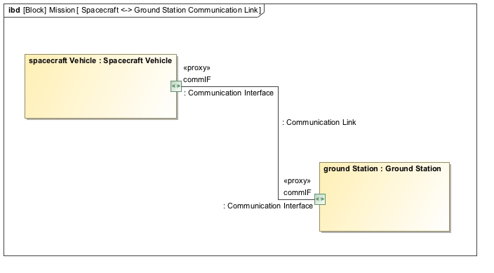
Running Example: Simple Space Mission
How long does it take to transmit all of the science data? What is the battery level profile over time?
Notes:
Ground station and spacecraft
Spacecraft sends data, to ground station, ground station pings
Spacecraft is in eclipse, or not, collects power, uses power

Slide 7
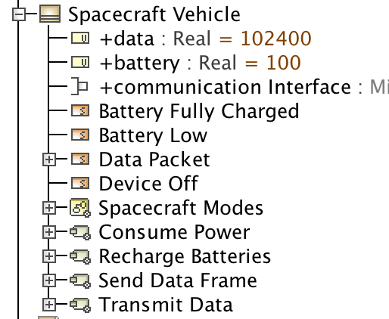
Owned vs. Classifier Behavior
Specification of (owned) behavior of the object that is possibly invoked at some point in time
Recharge Batteries
Transmit Data
…
➔ Typically modeled using activity diagrams
The classifier behavior is the specification of the behavior of an object over its full lifecycle
➔ Typically modeled using state machines
Notes:
When an instance of a behaviored classifier is created, its classifier behavior is invoked.

Slide 8
What are Activities?
Behavior described by the activity diagram
Transformation (Activity)
Input
Output
System boundary for input-transform-output process
Modeling questions:
What is the (system) boundary?
What are the inputs & outputs?
What are the object flows (things flowing through in/outs)?
What is the transformation taking place?
How is the transformation controlled?

Slide 9
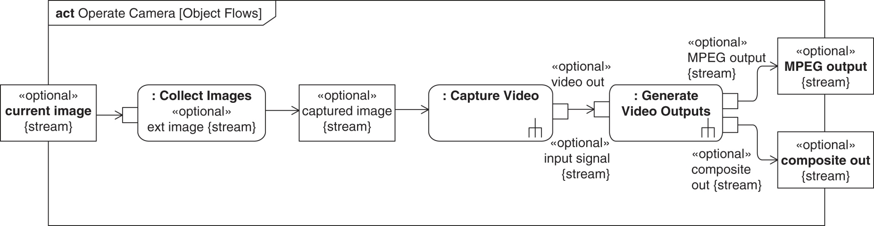
Activity Diagrams
Specification of behavior through controlled sequence of actions
An activity is decomposed into multiple actions with connecting flows
Sequence of execution controlled by how tokens flow through and trigger actions

Slide 10
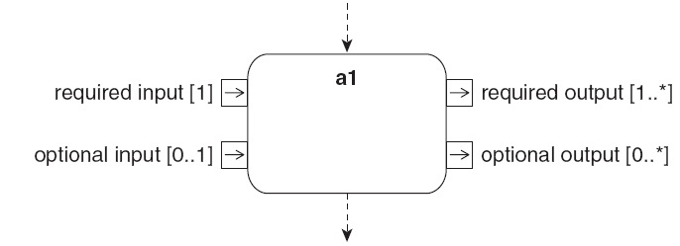
Formal Action Semantics: Token Flow
Two types of flow: object and control flow
Object tokens flow through pins
Multiplicity specifies required number of tokens
Can have optional inputs/outputs
Control tokens don’t require pins
The behavior, a1, is not initiated until all the input pins have the required number of tokens and all the control inputs also have a token
When the behavior ends, we expect all the output pins to have the required number of tokens and all the control outputs also get a token

Slide 11
Routing Flows
Initial Node – On execution of parent control token placed on outgoing control flows
Activity Final Node – Receipt of a control token terminates parent
Flow Final Node – Sink for control tokens
Fork Node – Duplicates input (control or object) tokens from its input flow onto all outgoing flows
Join Node – Waits for an input (control or object) token on all input flows and then places them all on the outgoing flow
Decision Node – Waits for an input (control or object) token on its input flow and places it on one outgoing flow based on guards
Merge Node – Waits for an input (control or object) token on any input flows and then places it on the outgoing flow
Guard expressions can be applied on all flows
Notes:
Make sure to talk about guards here

Slide 12
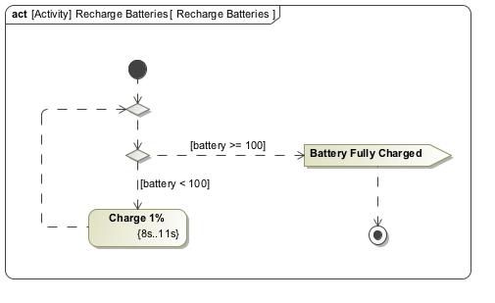
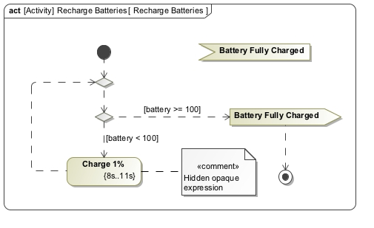
Sending & Receiving Signals
Signals can be sent and received and can act as triggers
Send signal
Signals can be sent over ports for inter-object communication!
Wait for / receive signal (e.g., to trigger other behavior)
(“Accept Event Action”)

Slide 13
Specifying Duration of (Leaf) Actions
Can apply “duration constraints” to leaf (non-decomposed) actions to specify their minimum and maximum execution time
min…max execution time

Slide 14
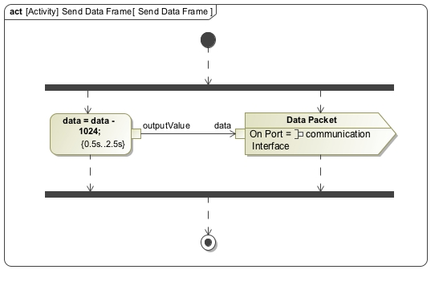
Opaque & Primitive Actions
Variety of languages supported: JavaScript, VB, Alf, fUML, …
Signals can carry payload
Notes:
(Maybe merge with previous slide)
Variety of other notations supported
E.g.: JavaScript can be embedded
Also supports foundational UML (fUML)

Slide 15
Sending Signals via Ports
Notes:
(Maybe merge with previous slide)
Variety of other notations supported
E.g.: JavaScript can be embedded
Also supports foundational UML (fUML)

Slide 16
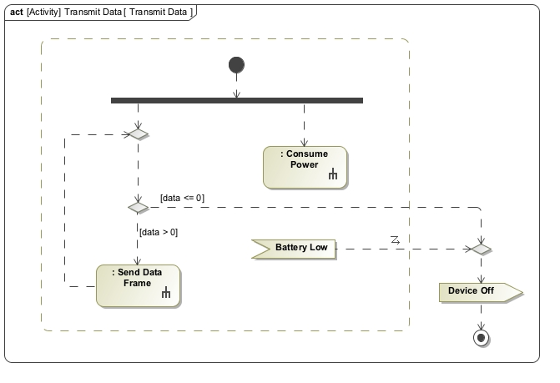
Concrete Example: Sending Data to Earth
Interruptible Region
Interrupting edge
Notes:
Drain battery, send data to Earth

Slide 17
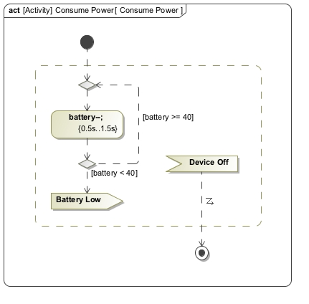
Concrete Example: Sending Data to Earth
Decomposed activity
Notes:
Drain battery, send data to Earth
An action can invoke another activity

Slide 18
Exercise
In which order do the actions execute?...Trace the tokens!
act
Example
Action
out1
in1
A2
a1
a2
out1
in1
A1
out1
[x>0]
[x<=0]
Guard Condition
in1
A3
A4
a3
a4
out1
out1
in2
in1
out1
A5
in2
a5
out2
Notes:
Token flow semantics
E.g., “name the order in which activities are visited”, then “what happens in this diagram” as stretch goal
Mention that very important to imagine this flow when modeling
Not checked automatically (requires simulation)
Can get “stuck” in states
Cameo will visualize active actions to make easier to debug
X=0
00:00:03,684 INFO: [event] Fire activity=Example action=a2 00:00:04,884 INFO: [event] Fire activity=Example action=a1 00:00:07,899 INFO: [event] Fire activity=Example action=a4 00:00:12,700 INFO: [event] Fire activity=Example action=a5

Slide 19
Agenda
What is Cameo Simulation Toolkit?
Specifying Behavior in SysML
Owned vs. Classifier Behavior
Activity Diagrams
State Machines
Executing System Behavior Simulations
Demo
Key Take-Aways

Slide 20
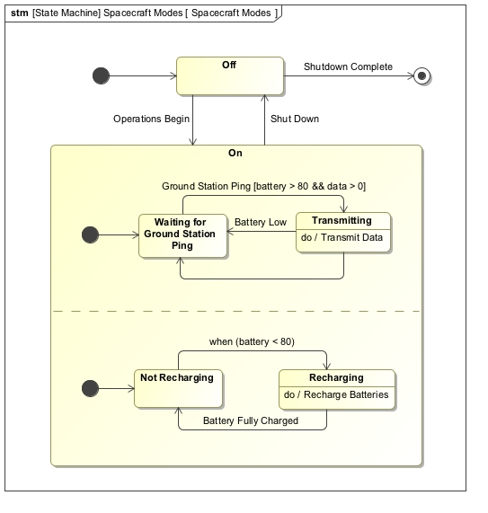
State Machines
States (or “modes”) and transitions between states
Transitions based on trigger and guard
Can send / receive signals to communicate between blocks
Typically used to represent the life cycle of a block
Can include nested sequential or concurrent states
Notes:
W3C SCXML
States and transitions
Signals can triggers transitions
Parallel states
Beginning nodes, end nodes
Mention differences to before: not all incoming edges need to be fulfilled, just one

Slide 21
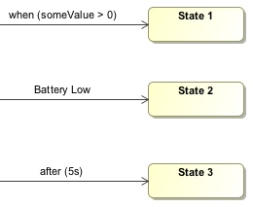
State Transitions
Three major types of events for transitions:
Change event
Signal event
Time event (relative (after) or absolute (at))
Transition notation: trigger[guard]/action

Slide 22
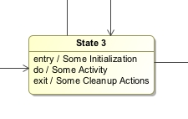
State-Dependent Behavior: Entry / Do / Exit Behavior
Three major types of activities:
Entry: when transitioning into state
Do: when in state
Exit: when leaving state
➔ Usually detailed with activity diagrams

Slide 23
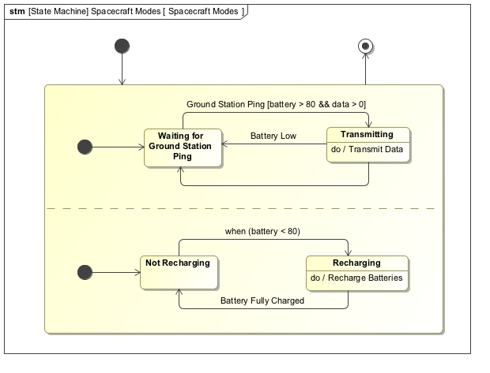
Concrete Example: Power & Comm Modes
Notes:
Signal sent via port

Slide 24
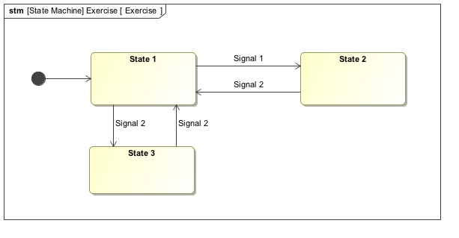
Exercise
Trace the state transitions!
Notes:
State 3

Slide 25
Agenda
What is Cameo Simulation Toolkit?
Specifying Behavior in SysML
Owned vs. Classifier Behavior
Activity Diagrams
State Machines
Executing System Behavior Simulations
Demo
Key Take-Aways

Slide 26
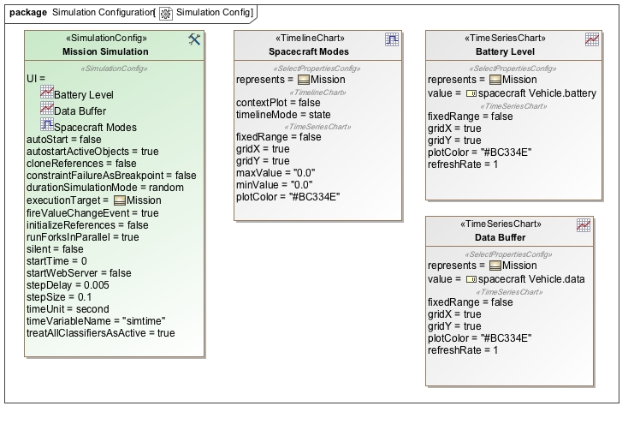
Preparing the Simulation Run
Notes:
Creating an instance
Create a simulation configuration

Slide 27
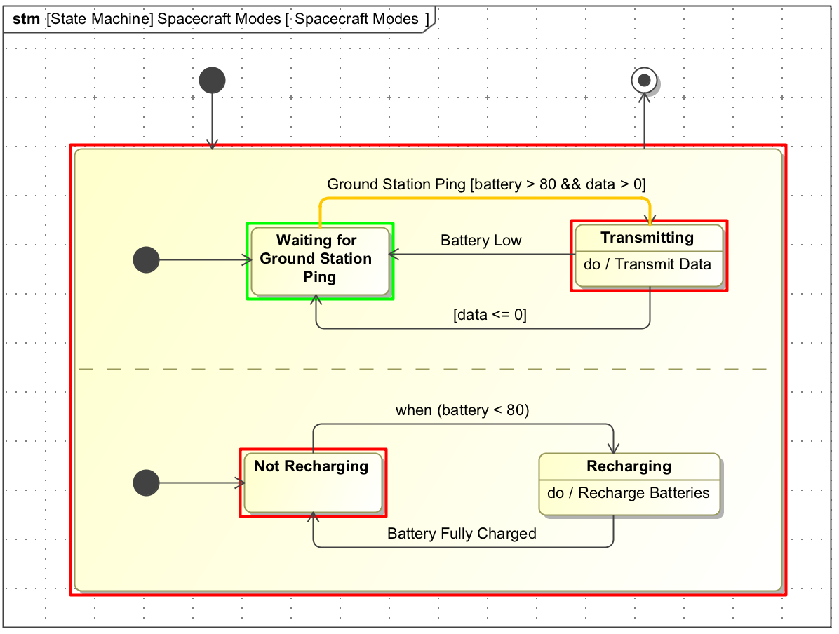
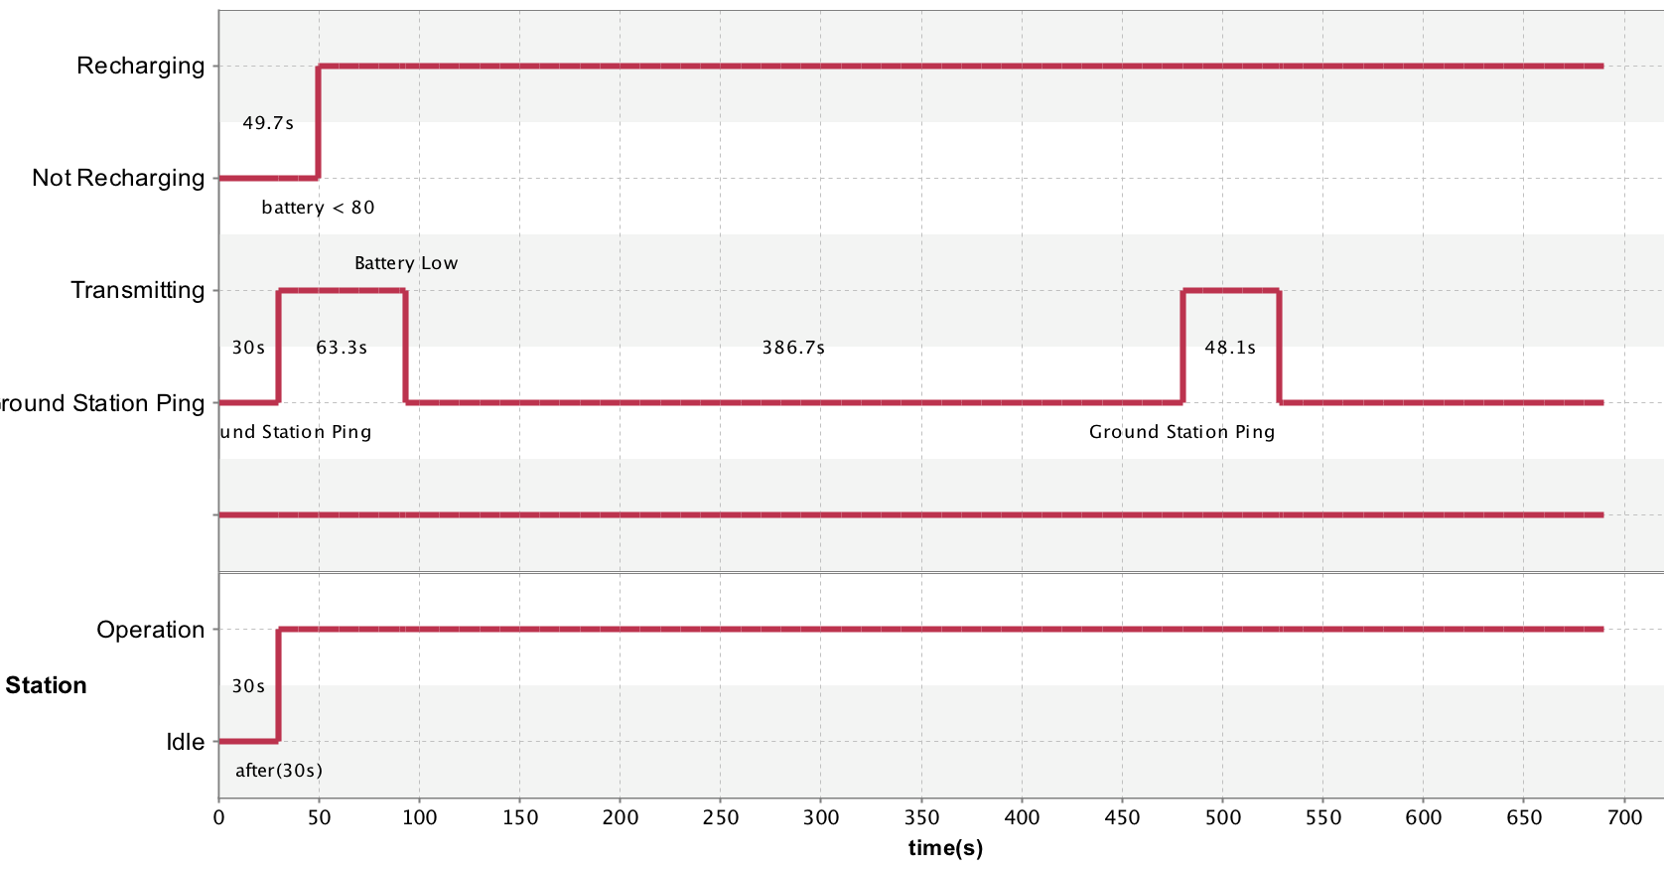
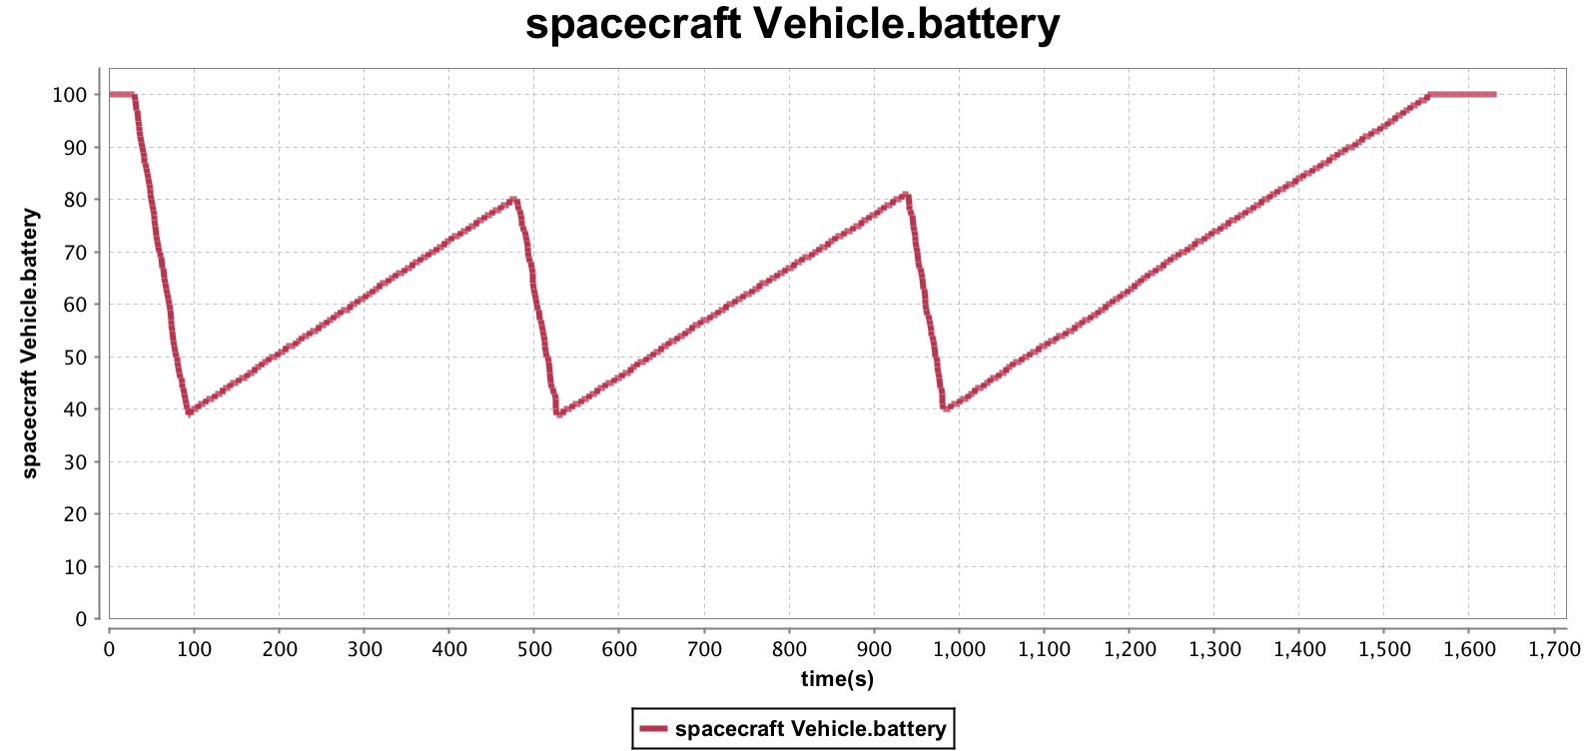
What is the Cameo Simulation Toolkit?
Model execution framework for validating system behavior
Discrete event simulation
Model debugging and animation
Model-driven test cases & checking requirements
Pluggable solver / simulation engines, languages and evaluators
Is a commercial plugin for MagicDraw developed by NoMagic
Notes:
validate system behavior by executing, animating, and debugging SysML Parametric models
From boxology to executable models
Forces strict adherence to semantics
A discrete-event simulation (DES) models the operation of a system as a discrete sequence of events in time. Each event occurs at a particular instant in time and marks a change of state in the system.^{[1]} Between consecutive events, no change in the system is assumed to occur; thus the simulation can directly jump in time from one event to the next.

Slide 28
Seeing the Model Come to Life
Notes:
SysML model activities and states, red and green
Timeline

Slide 29
Seeing the Model Come to Life
Notes:
SysML model activities and states, red and green
Timeline

Slide 30
Seeing the Model Come to Life
Notes:
SysML model activities and states, red and green
Timeline
Time series chart

Slide 31
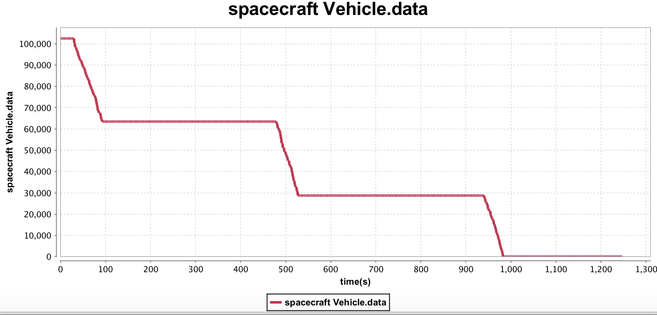
Seeing the Model Come to Life
Notes:
SysML model activities and states, red and green
Timeline

Slide 32
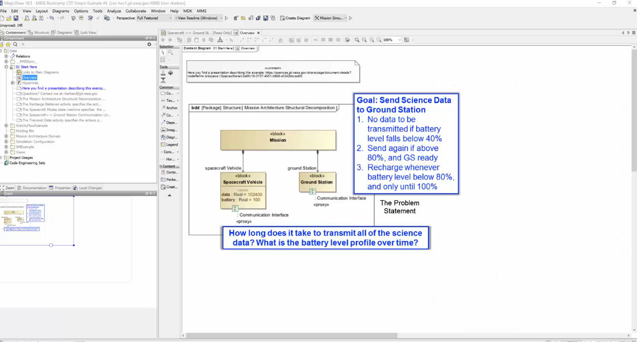
Demo

Slide 33
Other Features & Common Uses of Cameo Simulation Toolkit
Support for SysML Interaction Diagrams
Parametric solving through:
Standard languages (JavaScript, VBScript, ALF, …)
External tool integration (STK, OpenModelica, Matlab, ...)
Requirements verification
Power, mass and other roll-ups
User interface mockups
Trade studies
Notes:
ALF: Action Language for Foundational UML

Slide 34
Other Features & Common Uses: Requirements Verification
(Source: Nerijus Jankevicius)

Slide 35
Other Features & Common Uses: Requirements Verification
(Source: Nerijus Jankevicius)

Slide 36
Key Take-Aways
Variety of ways to specify behavior in SysML, fully interconnected with structure (and parametrics, requirements)
SysML is not just “boxology”, and diagrams are not just pretty pictures!
Highly complex simulations can be built with only a few model elements
Model rigorously, and you shall be rewarded!

Slide 38
BACKUP SLIDES

